Slide 1
Welcome
“Excel is a spreadsheet for typing stuff into.”
Yes, but today we’re going way beyond that.

Slide 2
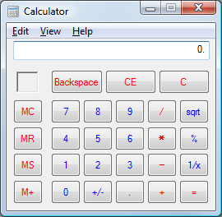
Calculator
(“countulator”)

Slide 3
Calculator
Everyone has this calculator on their Windows computer. (This is how it looks in Windows Vista, but you get the idea.)

Slide 4
Super Calculator
Excel is a “super calculator.” It can help you do calculations just like on a calculator, only easier in some ways.
Well, a lot of ways.

Slide 5
1+1=
This is an equation. It’s simple, but it has all the parts—numbers and an “equal” symbol.

Slide 6
1+1=
It’s a math’s way of asking a question. In this math, you are the “thinker”—you are the one who needs to answer the question.

Slide 7
1+1=
In Excel, you get to ask the questions and make the computer do the thinking for you. More on this later.

Slide 8
“Equation” or “Formula”?
Formula. Equation. Whatever—for our discussion, they’re the same thing.

Slide 9
Words
Usually we’ve heard these math problems referred to as “equations.”
But…

Slide 10
Formula
We’ll use “formula,” because that’s what Excel calls ‘em. Your book does, too.

Slide 11
1+1=_
This is one of the first formulas we learned as kids.
Our job was to fill in the blank.

Slide 12
1+1=?
The blank was a way of asking a math question. Sometimes we had to think pretty hard to get the right answer—we graduated past “1+1” pretty early.

Slide 13
1+1=x
Later, they threw a curve ball at us. They took away our blanks, They took away our question marks, and gave us a little, italic x instead.

Slide 14
1+1=x
We didn’t mind, because we were doing the same sort of work, just with an x instead of a blank.

Slide 15
1+1=2
This is that first formula, with its answer.
It’s important that it uses an = symbol.

Slide 16
1+1=2
This is that first formula, with its answer.
It’s important that it uses an = symbol.

Slide 17
1+1=2
The = tells us that no matter what is on one side of it, the other side has to add up to be the same thing.

Slide 18
1+1=2
You can even move from one side to the other, as long as all the parts move at the same time. So, this formula is really the same as…

Slide 19
2=1+1
This one.

Slide 20
_=1+1
Here we are, back with a familiar formula. We hid the answer, hoping that you’ll be able to remember it.

Slide 21
?=1+1
Now the “unknown” comes first. To figure out the formula, we focus on the items to the right of =.

Slide 22
=1+1
You can even delete the question mark and blank, and it’s still obvious what it’s wanting.

Slide 23
=1+6-2
Adding numbers and operands (+,-,×,÷) doesn’t change how it works.

Slide 24
=1+6-2
And, it doesn’t change how that = symbol is still begging for an answer.

Slide 25
How does this apply to Excel?
I’m glad you asked.

Slide 26
2
There are two basic types of things you can type into an Excel cell:
Data (numbers, letters, whatever)
Formulas

Slide 27
Data
Excel displays whatever you type into a cell. You can type the Gettysburg Address, your phone number, or…well, anything. This is data, and it’s your responsibility to make it accurate.

Slide 28
Data
Data is stuff you have to think about.

Slide 29
Formulas
Formulas are things Excel has to think about.

Slide 30
Formulas
With formulas, you get to ask the questions.
But you need to know how to phrase the questions properly.

Slide 31
Communicate
In all of your business communications, you should communicate clearly.
You may have a burning question, an urgent question, and may ask all the right people, but…

Slide 32
How did the dog?
If you don’t phrase it correctly, you won’t get a good answer.
You might even get a chuckle and a dismissive shake of the head.

Slide 33
How did the dog?
Not just because you are urgently asking someone about a dog, at work, but because you didn’t ask it using a complete sentence.

Slide 34
How did the premium dog food sell last quarter?
You must construct a sentence correctly for it to be interpreted correctly.

Slide 35
Numbers
Excel is the same way.
Excel does many very complicated and smart-looking things, but in some ways, it’s as dumb as a stump.

Slide 36
Stump.
You have to type a formula just so, or it will look at you like a puppy does when you ask it to recite the Pledge of Allegiance.

Slide 38
Words.
More words.
In English, how words are put together properly is called “grammar.”

Slide 39
Syntax
In Excel, how formulas are put together properly is called “syntax.”
When you hear “syntax,” think “grammar.”

Slide 40
Your first formula
Ready to type your first formula?

Slide 41
Your first formula
If you typed some of the formulas on the slides earlier, you already have.

Slide 42
=1+1
Type this into any Excel cell, then press Enter.

Slide 43
2
When you press Enter, your super calculator (Excel) gives you the answer.

Slide 44
=1+1
It gave you the correct answer to this question because you phrased the question correctly.

Slide 45
=1+1
Whenever the first thing you type in a cell is =, Excel wags its puppy dog tail and thinks, “Formula! It’s a formula!”

Slide 46
2
And whenever Excel recognizes something as a formula, it doesn’t show you the formula, it shows you the answer.

Slide 47
Next formula
Let’s make the formula a little more complicated.

Slide 48
=5+5-2
This should give you “8” for an answer.

Slide 49
What about oopses?
How will I know if I used the right syntax?

Slide 50
#VALUE!
If something’s wrong, this is the most common thing you’ll see displayed in the cell.
If Excel doesn’t see it as a formula, then it will just display what you typed.

Slide 51
Next formula
Ready for the next one to try?

Slide 52
7+3-2+6
Without typing in Excel, what answer do you think Excel would give for this equation?

Slide 53
#VALUE!
If you guessed:
You get a star on your forehead.
Metaphorically.

Slide 54
7+3-2+6
Why? What was missing?

Slide 55
=7+3-2+6
That little = makes a world of difference!

Slide 56
More symbols

Slide 57
Remember this?

Slide 58
Some things may look a little different than you expect.

Slide 59
Some things may look a little different than you expect.

Slide 60
You may have seen these on your cell phone’s calculator:
/ = divide
* = multiply

Slide 61
=4*5
Let’s try them out.
This formula is the same as what you might find printed in a math textbook as “4×5.”
Excel should display “20.”

Slide 62
=3+5*2
If you use any operations besides “+” and “-,” you should be careful.
Examine this formula.

Slide 63
=3+5*2
Excel is going to run the multiplications before it runs the additions. It’s just the way Excel thinks, and we have to deal with it.

Slide 64
=3+5*2
(This order that it works with is called its “order of operations,” which happens to be the same order as algebra’s “order of operations.”)

Slide 65
=3+5*2
We’d have a problem if what we wanted Excel to compute was the 3+5 before multiplying it all by 2.

Slide 66
=3+5*2
Excel would first multiply 2*5, then add 3.
Excel would return an answer of “13.”
But if we needed a different answer—if we wanted it to add before it multiplied—we need to phrase the question differently.

Slide 67
=3+5*2
We need to use better syntax to help Excel think its way to the “correct” answer.

Slide 68
( )
Behold the mighty parentheses.

Slide 69
(
Alone, it’s called a “parenthesis.” Note the “i.”

Slide 70
(
We hardly ever hear it called that because they’re almost always used in pairs.
Plural: parentheses

Slide 71
( )
You can use parentheses to group items together that you want computed together.

Slide 72
( )
As in good grammar, you should always use these in pairs. If you insert one, you should insert the other somewhere in the same formula. That’s proper syntax.

Slide 73
( …
If you don’t include a companion for a lonely parenthesis, it really, really bugs Excel.

Slide 74
The facts (which were up for dispute until last week substantiate his claims of innocence.
Just like it bugs people.

Slide 75
=(3+5)*2
Using parentheses (or “parens” for short) tells Excel to do the addition (inside the parens) before the stuff on the outside of the parens—the multiplication.

Slide 76
16=(3+5)*2
Using parentheses, we’d get the answer we were after: “16.”

Slide 77
If you forget a paren, Excel lets you know.
In a simple formula, Excel suggests a fix.
In a complex formula, it’s up to you.

Slide 78
Not just a super calculator
So far, all we’ve done is formulas that mimic what we’d tap into a calculator. But this is Excel, and it can do so much more.

Slide 79
Type data
First, let’s type some data to play with.

Slide 80
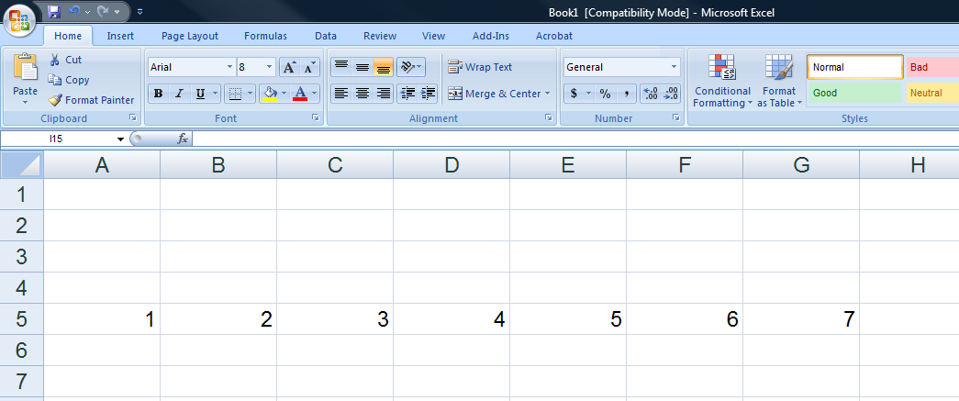

Slide 81
=B5
Select cell A1, then enter this formula.

Slide 82
=B5
Whenever Excel sees a letter/number combo like this within a formula, it knows you’re referring to a cell reference.

Slide 83
=B5
The “question” this formula is asking is, “What’s in cell B5?”
The answer: “2”

Slide 84
=(3+5)*2 =(C5+E5)*B5
You can use cell references in a formula just like you can use numbers. Just make sure it contains the unique cell reference and that there are no spaces between the letter and number.

Slide 85
=(C5+E5)*B5
This returns an answer just as quickly as your number formula did.
The answer should be “16.”

Slide 86
=(C5+E5)*((B5*2)+3)
You can group many parts of a formula together using sets of parentheses.
Sometimes it helps to plan (and decipher) a formula by separating the pieces on scratch paper.

Slide 87
(C5+E5)*([B5*2]+3)
In Algebra, you would have used brackets [like this] to help mark a nested group.
You also may have used braces {like this}.

Slide 88
(C5+E5)*([B5*2]+3)
But Excel can figure it out with just parens, so forget about those other fancy-pants symbols while working in formulas.

Slide 89
=((((: :))))
Use as many parentheses as you need.
You’ll never run out.

Slide 90
Words, words, words…
You can also use words in a formula, but they must be words that Excel understands—and they all relate to how the numbers are computed.

Slide 91
SUM
Remember AutoSum?
Select the cell H5 (to the right of the numbers you entered), then click the AutoSum button and press Enter.

Slide 92
=SUM(A5:G5)
Now select cell H5 again to see the formula it had inserted. It should look like this one.

Slide 93
=SUM(A5:G5)
“SUM” tells Excel to add the cells.

Slide 94
=SUM(A5:G5)
A colon between two cell references tells Excel that you’re adding together all values within the range A5 to G5.

Slide 95
=SUM(A5:G5) =A5+B5+C5+...
You could type the formula by hand, too—the AutoSum button just makes it easier.
You could also type or click the individual cells, if you want.

Slide 96
Computer Programming
Look at the first formula you entered.

Slide 97
=1+1
This is belated, but…
Congratulations!

Slide 98
=1+1
You just wrote your first computer program.

Slide 99
=1+1
Not a lot of people will call it that, but look at it this way:
You just typed instructions to the computer using a language (proper syntax) it could understand.

Slide 100
=1+1
It was a short program.
The cell was the “editor.”
Pressing “Enter” ran the “compiler.”
And the program run, and gave you “2.”

Slide 101
=1+1
It may not seem like much, but world-changing journeys have begun that started just as simply.

Slide 102
7+3-2+6
Remember this formula? And something was wrong with it?
And you figured out what was missing?

Slide 103
=7+3-2+6
In Excel, as in computer programming, trying to find the problem with what you typed is called “debugging.”

Slide 104
=7+3-2+6
So, another “Congratulations!”
You have debugged your first program.

Slide 105
Words
“Syntax,” “formula,” “debugging” are only words, and nothing to be afraid of.
Ask if you need help—I’m here.

