Slide 1
Simple Scheduling
Mike Sawyer
bit.ly/simpleshedule
#STC15
@Akambe

Slide 2
Preview
Focus: Small business, small budget
Spreadsheet basics (optional)
Schedule formatting & printing
Schedule fields, sorting, & filtering
Handy schedule formulas & functions
Best practices
Features: What, then how
#STC15
@Akambe

Slide 3
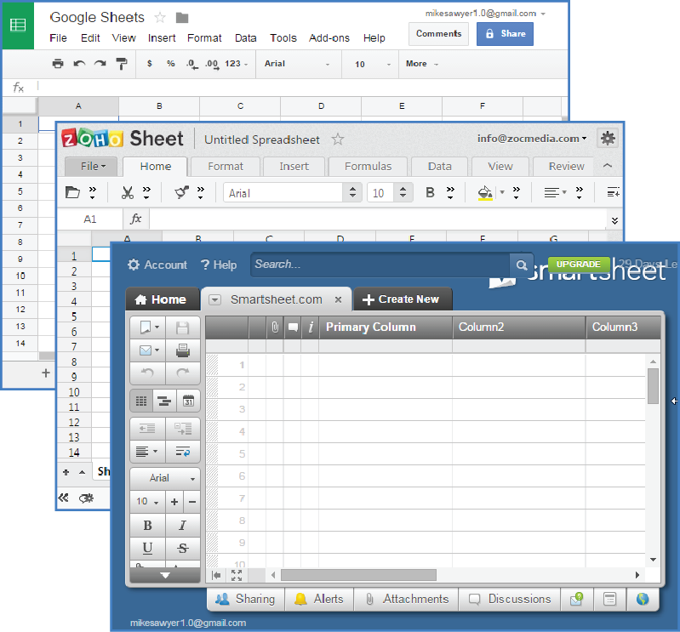
Free Spreadsheet Alternatives
Google Sheets
Zoho
Smartsheet.com
Excel web app
SoftMaker FreeOffice
OpenOffice
LibreOffice
LucidChart
Kingsoft Office Free
iWork Numbers (Mac & Web)
NeoOffice (Mac)
#STC15
@Akambe

Slide 4
Using a Spreadsheet as a Schedule
Formalizes project schedule & plan
At-a-glance (no DB report)
Easy & adaptable
Track progress & history
Packages other handy reference info
Transitory—not permanent
Start with a prototype, modify as you go
Contents vary depending on your needs
#STC15
@Akambe

Slide 5
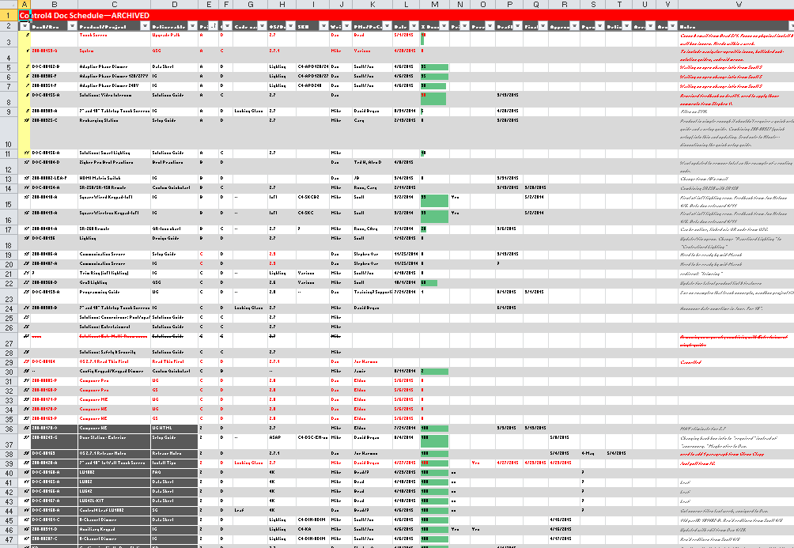
My Schedule (Smallified)
#STC15
@Akambe

Slide 6
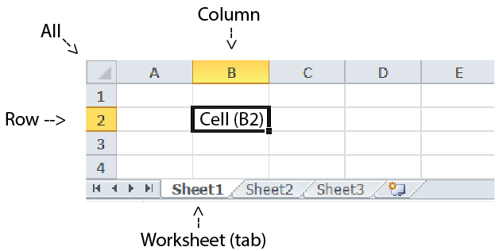
Spreadsheet Basics
#STC15
@Akambe

Slide 7
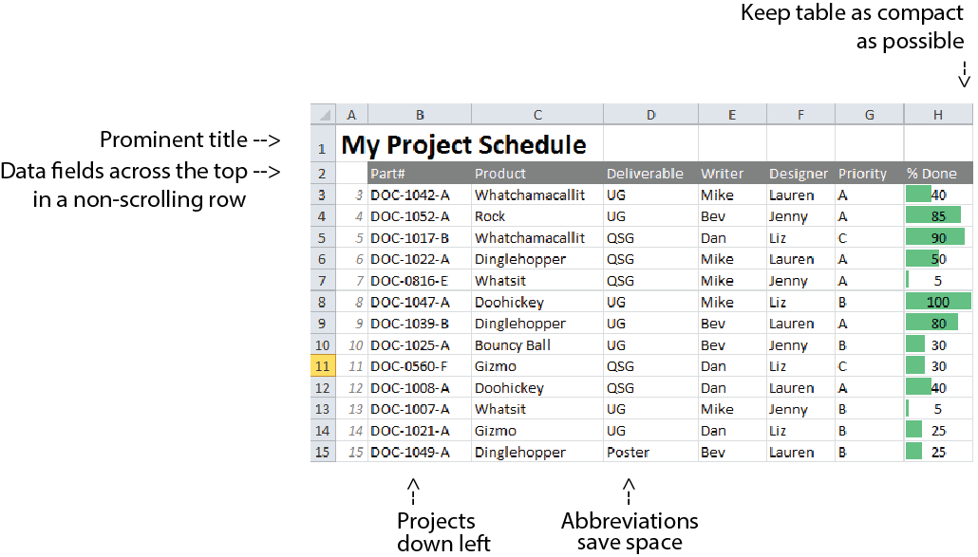
Layout
#STC15
@Akambe

Slide 8
Resizing Columns: How
#STC15
@Akambe

Slide 9
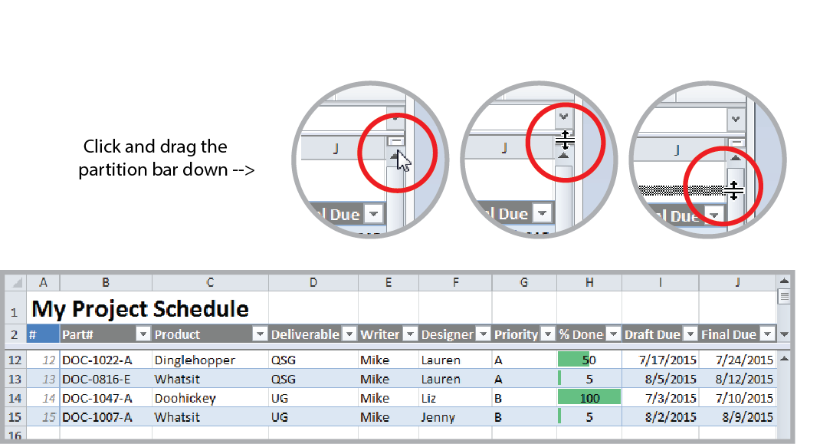
Non-scrolling Row: How
#STC15
@Akambe

Slide 10
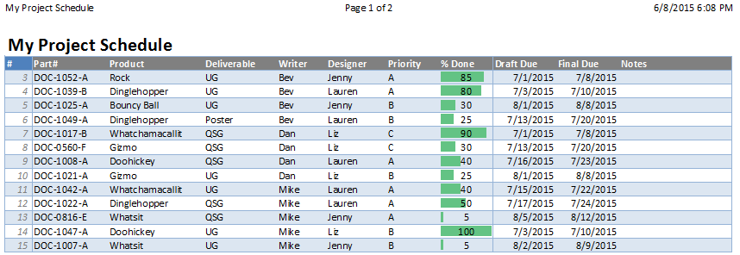
Printing
Print landscape (with narrow margins) to fit more →
Print to Legal for more columns per page
#STC15
@Akambe

Slide 11
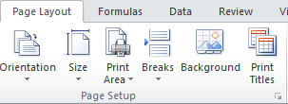
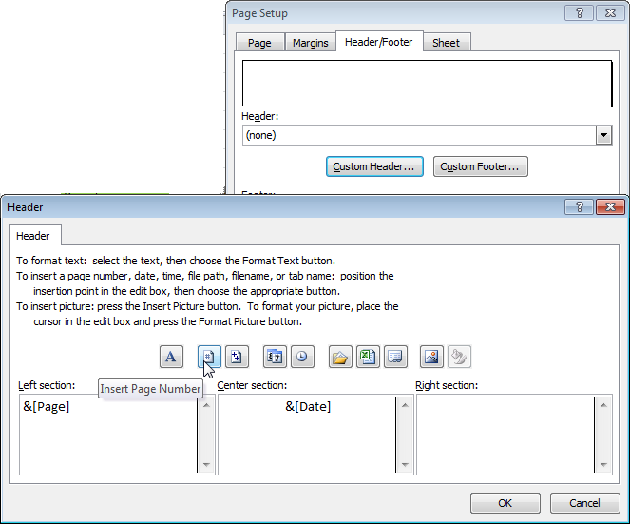
Header/Footer: How
#STC15
@Akambe

Slide 12
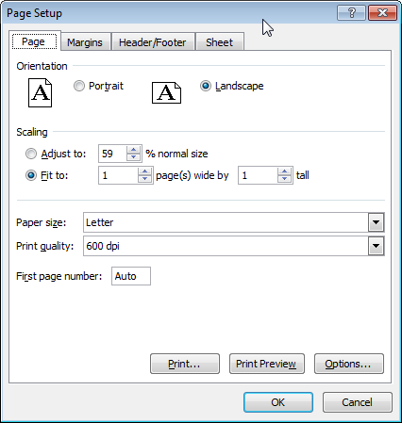
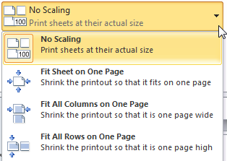
Shrink-to-Fit Printing: How
#STC15
@Akambe

Slide 13
Formatting
Home ribbon
Can format characters
Easiest to treat cells as mini paragraphs
Vertical alignment “top” or “center”
Wrap Text to avoid truncating
Short date/currency formats (“remembering”)
Borders and shading to emphasize
#STC15
@Akambe

Slide 14
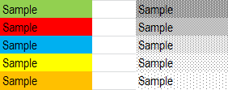
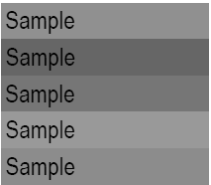
Formatting
Color if you can print to color; patterns for B/W
Small, narrow fonts, and abbreviations to fit more info
#STC15
@Akambe

Slide 15
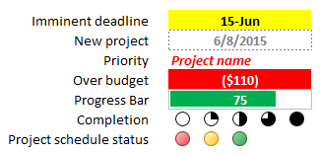
Conditional Formatting
Quantities, percentages, ratings (Values can be visible or hidden)
#STC15
@Akambe

Slide 16
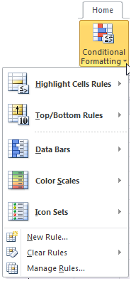
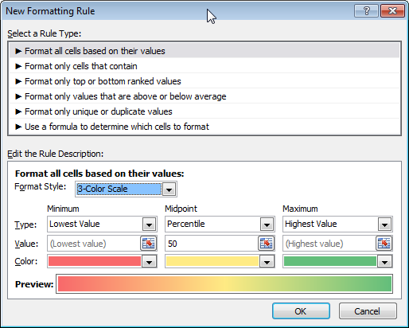
Conditional Formatting: How
#STC15
@Akambe

Slide 17
Fields
Descriptive
Doc part#/Rev
Product (or project)
Deliverable (UG, QSG, help, etc.)
Format of output
Priority
Audience
Code name
Product part#/ model
Writer & designer
PoCs/Reviewers
Budget planned
Notes
Measuring
Elapsed time since start (work days vs. true days)
Days before due
Hours (for billing)
Budgeted hours remaining
Goals & Gates
Deadline
Edit due
Draft due
Final due
Historical
Date added
% done
Approved
Web posted
Delivered
Archived
Cost
Budget planned
Budget used
Budget remaining
#STC15
@Akambe

Slide 18
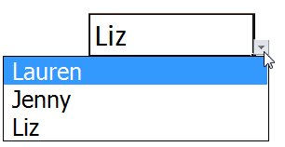
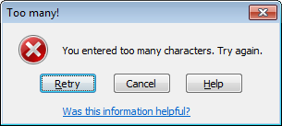
Data Validation
Allowed lists, types of data, allowed ranges of numbers & dates
#STC15
@Akambe

Slide 19
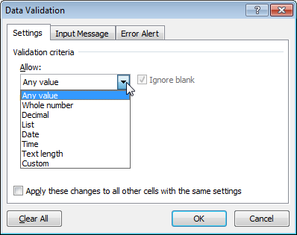
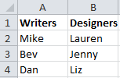
Data Validation: How
#STC15
@Akambe

Slide 20
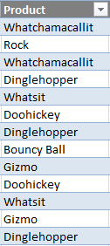
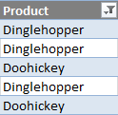
Make It a Table
Sorting
Filtering
+ Row striping
#STC15
@Akambe

Slide 21
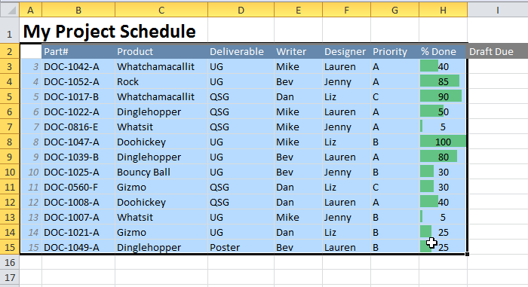
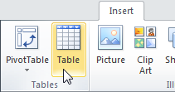
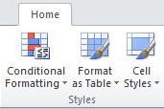
Make It a Table: How
#STC15
@Akambe

Slide 22
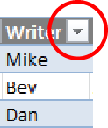
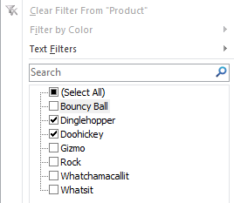
Sorting and Filtering: How
#STC15
@Akambe

Slide 23
Formulas
A formula:
Is an equation, starting with “=”
Transforms sheet from record keeping to computing
Typed in a cell, easily edited
Displays the value of the formula
Can use cell references, numbers, and functions
#STC15
@Akambe

Slide 24
Formula References & Math
Cell references
Column letter first, then row # (“A1”)
Math
Addition/Subtraction (A1+B2), (A1-B2)
Multiplication (A1*B2) or (A1)(B2)
Division (A1/B2)
Exponents (A1^2)
Nested operations A1*(3+(5*B2))
#STC15
@Akambe

Slide 25
Popular Schedule Functions
Like mini-programs that fit inside a formula (see handout for descriptions)
Average
Cell
Concatenate
Count
Countblank
Countif
Days360
Max
Median
Min
Networkdays
Now
Round
Row
Sum
#STC15
@Akambe

Slide 26
SUM (function)
Totals the values in a range.
#STC15
@Akambe

Slide 27
SUM (function): How
Totals the values in a range.
=SUM(B4:B12)
#STC15
@Akambe

Slide 28
Date Functions
Basic math operations (assumes days)
NOW, DAYS360, NETWORKDAYS
Compute time spans
Count in real days or weekdays
#STC15
@Akambe

Slide 29
Date Functions: How
=D5-C5 (simple subtraction)
=DAYS360(C5,D5) (difference in true days)
=NETWORKDAYS(C5,D5) (weekdays)
#STC15
@Akambe

Slide 30
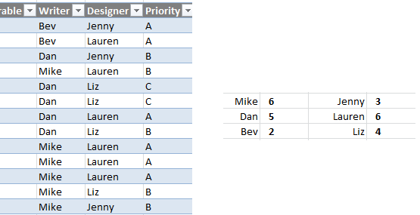
COUNTIF (function)
Counts how many of something is in the specified range.
#STC15
@Akambe

Slide 31
COUNTIF (function): How
Counts how many of something is in the specified range.
=COUNTIF(F3:F15,"Jenny")
#STC15
@Akambe

Slide 32
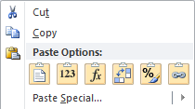
Copying Formulas: How
Copy/paste
Click & drag
Pasting a value
#STC15
@Akambe

Slide 33
Absolute References
When pasted, a formula automatically adjusts the [relative] cell references. "A1" can become "A3".
Absolute refs don’t change.
How: Insert "$" before each part of the cell reference you want to keep. (“$A$1")
#STC15
@Akambe

Slide 34
Best practices
Backing up & Archiving
Quarterly history
Naming worksheets
Master sheet/record (at project start and end)
Part numbers
Collaborative updates (concurrent: SharePoint, Box, Google Sheets, CollateBox)
#STC15
@Akambe

Slide 35
Collaboration
Taking turns: Shared network drive, DropBox
Concurrent: SharePoint, Box, Google Sheets, CollateBox
#STC15
@Akambe

Slide 36
More Resources
bit.ly/simpleschedule
This PowerPoint deck
Formula basics deck
Handout (PDF)
Starter schedule spreadsheet
Examples spreadsheet
#STC15
@Akambe

Slide 37
Q&A & Contact Info
Mike Sawyer
mike@sawyerhome.net
www.linkedin.com/in/mikesawyerprofile
@Akambe
#STC15
@Akambe

